Slide 1
ManDown A Social Drinking Management App
Arshan Shafiei, Daryl Ma, Diyar Alyasiri, Max Poynton,
Michael Hart, Santiago Rubio, Wei Cong Te

Slide 2
Social Drinking Management App
Passive + Active Data Collection
Social and Drinking Games
Classification of User State
Intoxication Alert

Slide 3
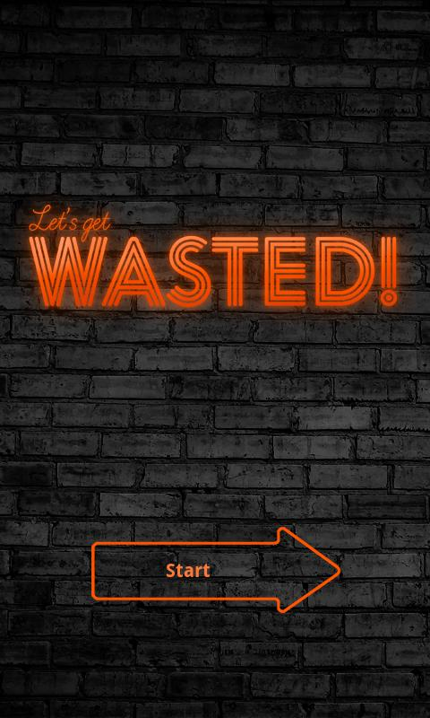
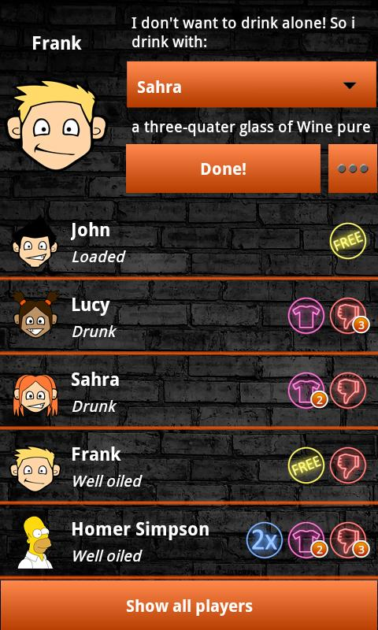
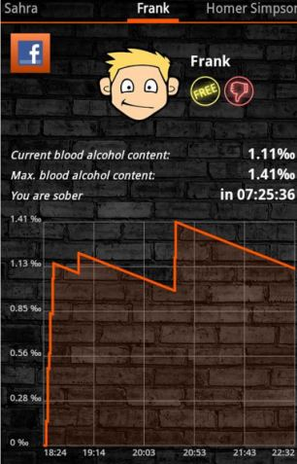
Similar Work

Slide 4
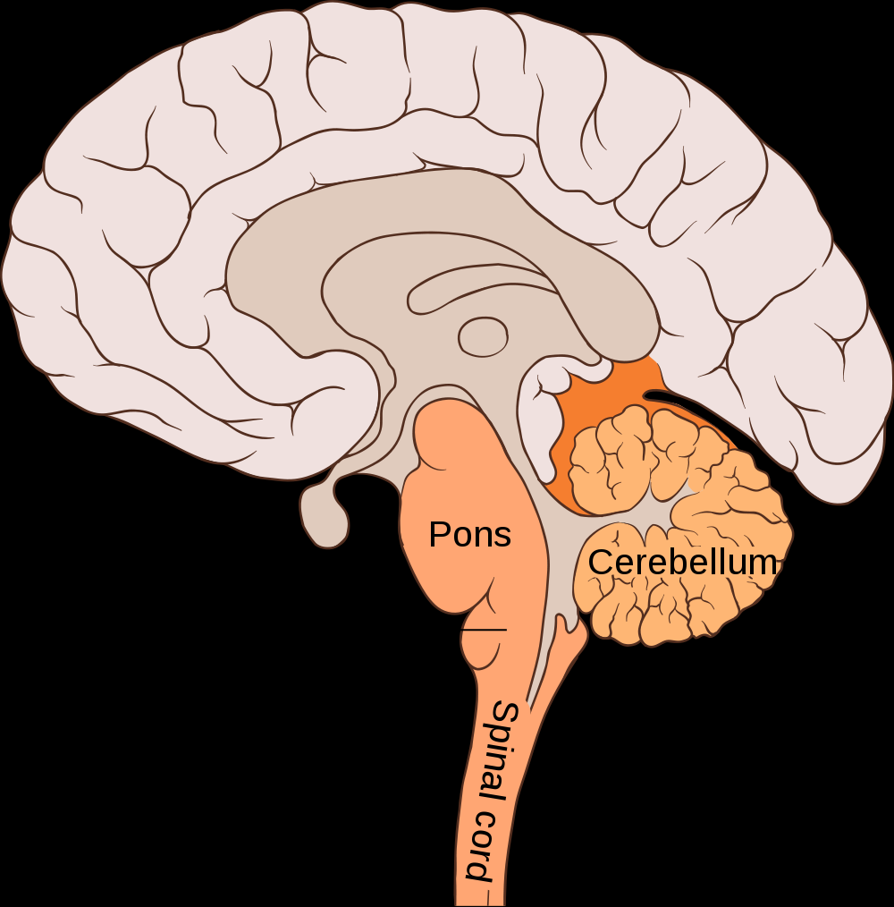
Medical Background

Slide 5
Sensors
9-axis data from mobile
Accelerometer
Gyroscope
Magnetometer
Accelerometer data from smartwatch
Touch input from screen combined with system time

Slide 6
Database
Local SQLite -> Cloud Firebase
No data loss – 5GB of free space - NoSQL JSON format – Real-time access
Data security -> User Authentication via Gmail
https://console.firebase.google.com/project/mandown-application/database/data

Slide 7
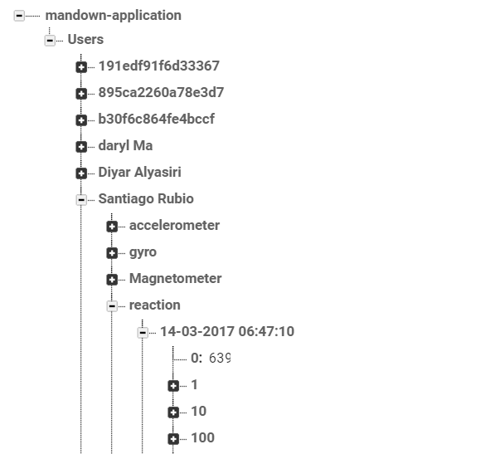

Slide 8
Machine Learning
Done on the cloud
Amazon Web Services
Multi-Class Classification
Sober (<0.20BAC), Tipsy (0.20 - <0.79BAC), Drunk (≥0.80BAC)
Real-time End Point
Predictor Request with Map of Attributes as Input

Slide 9
Data Collection
Unable to purchase alcohol through the college
Small scale testing within our team and friends
Direct control of alcohol consumption and therefore BAC
Ensure even collection of data for all classification levels (sober, tipsy, drunk)

Slide 10
Data Collection
Baseline: Sober, at least 3 hours since last meal
Play all the games, get walking data from both mobile phone and watch
Tipsy: Ingest 2 units of alcohol (175ml of wine) over 2 minutes and rest for 30 minutes
Record BAC levels, play games, walking data
Drunk: Ingest 4 units of alcohol (350ml of wine) over 2 minutes, rest 30 minutes
Record BAC, play games, walk

Slide 11
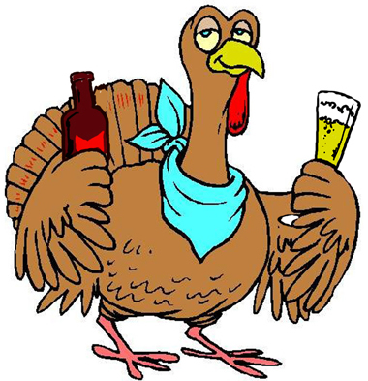
User Interface and Demonstration

Slide 12
Thank You Any Questions?

